Slide 1
Presentation on Detection and Automatic Gain Control (AGC)
Presented To:
Md. Imran Hossain
Assistant Professor
Department of ICT
Comilla University
Presented By:
Tanima Sultana Seema
Roll: 11809022
Session: 2017-18
Department of ICT
Comilla University

Slide 2
Simple diode detector Operation
The diode is by far the most common device used for AM demodulation
Fig. 1: Simple diode detector (a) Circuit diagram (b) input and output voltages.

Slide 3
Simple diode detector Disadvantage
V0, in addition to being proportional to the modulating voltage, also has a dc component, which represents the average envelope amplitude (i.e., carrier strength), and a small RF ripple.
The unwanted components are removed in a practical detector, leaving only the intelligence and some second harmonics of the modulating signal.

Slide 4
Practical diode detector Operation
Following additions have been made to the simple detector in its practical version.
The diode has been reversed, so that now the negative envelope is demodulated.
This has no effect on detection, but it does ensure that a negative AGC voltage will be available.
Fig. 2: Practical diode detector

Slide 5
Automatic Gain Control (AGC) Characteristics
Simple AGC is a system by means of which the overall gain of a radio receiver is varied automatically with the changing strength of the received signal, to keep the output substantially constant.
A dc bias voltage, derived from the practical diode detector is applied to a selected number of the RF, IF and mixer stages.
The devices used in those stages are ones whose transconductance and gain depends on the applied bias voltage or current.
Fig. 3: Simple AGC characteristics

Slide 6
Automatic Gain Control (AGC) Applications
All modem receivers are furnished with AGC, which enables tuning to stations of varying signal strengths without appreciable change in the volume of the output signal.
AGC "irons out" input signal amplitude variations, and the gain control does not have to be readjusted every time the receiver is tuned from one station to another, except when the change in signal strengths is enormous.
AGC helps to smooth out the rapid fading which may occur with long-distance shortwave reception and prevents overloading of the last IF amplifier which might otherwise have occurred.

Slide 7

Distortion in Diode Detectors
Two types of distortion may arise in diode detectors.
One is caused by the ac and de diode load impedances being unequal
Other by the fact that the ac load impedance acquires a reactive component at the highest audio frequencies.
The modulation index in the demodulated wave is defined as:
Fig. 4: Detector diode currents

Slide 8
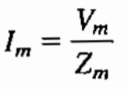

Distortion in Diode Detectors (Continued)
We can see that,
and
Where, Zm = audio diode load impedance and Rc = dc diode load resistance
The audio load resistance (Zm) is smaller than the dc resistance (Rc). Hence it follows that the AF current Im will be larger, in proportion to the de current (Ic), than it would have been if both load resistances had been exactly the same.
The modulation index in the demodulated wave is higher than it was in the modulated wave applied to the detector.

Slide 9



Distortion in Diode Detectors (Continued)
The resulting diode output current, when the input modulation index is too high for a given detector is shown in Fig. 4(b). It exhibits negative peak clipping.
The modulation index in the demodulated wave will be:
Since the maximum tolerable modulation index in the diode output is unity, the maximum permissible transmitted modulation index will be:

Slide 10
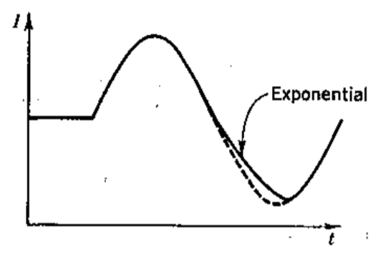
Diagonal Clipping
Diagonal clipping is the name given to the other form of trouble that may arise with diode detectors.
At the higher modulating frequencies, Zm may no longer be purely resistive;
it can have a reactive component due to C and C1. At high modulation depths current will be changing so quickly that the time constant of the load may be too slow to follow the change.
As a result, the current will decay exponentially, as shown in Fig. 5, instead of following the waveform.
This is called diagonal clipping.
Fig. 5: Diagonal Clipping

Slide 11
Thank You..

